Slide 2
Pouchdb, couchdb, firebase
Front end: web, app, desktop
Backend: http API, socket, GRAPH
DATABASE: MSSQL, MYSQL, NoSQL (couchdb, pouchdb, firebase, mongodb)
AngualarIO, Vue.js , React
Express….
IONIC, CORDOVA : WP, ANDROID,IOS
JS, TYPESCRIPT
JS, TYPESCRIPT

Slide 3
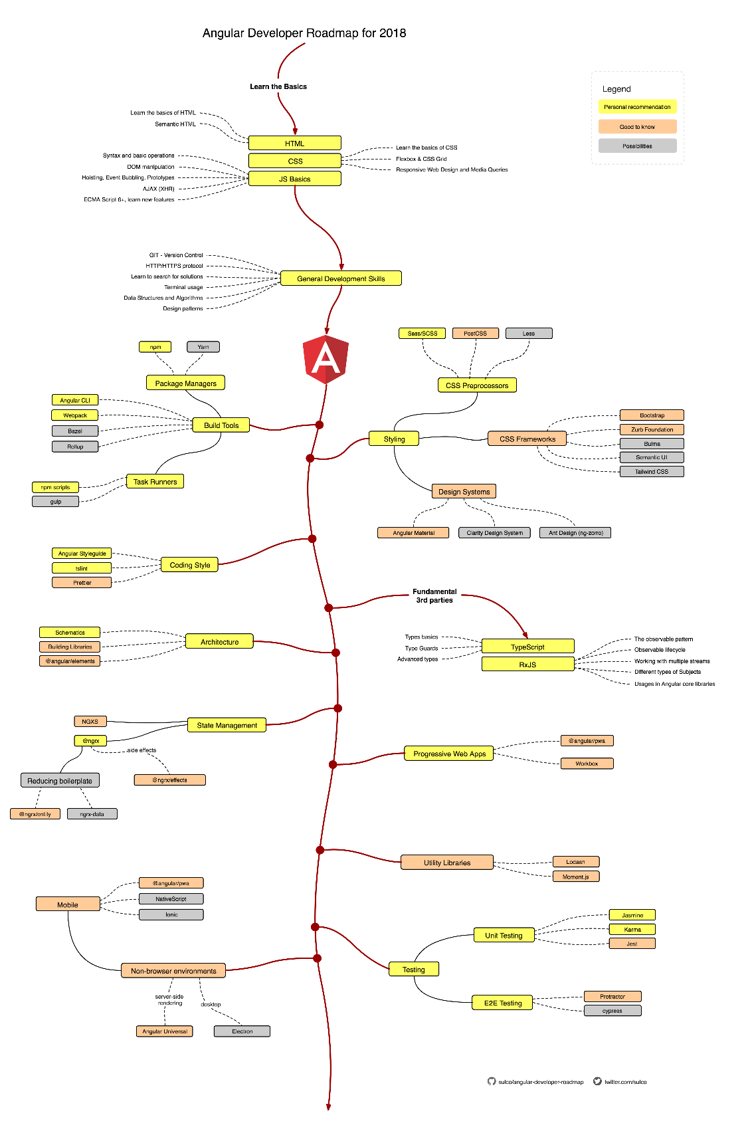
https://awesomeopensource.com/project/sulco/angular-developer-roadmap

Slide 4
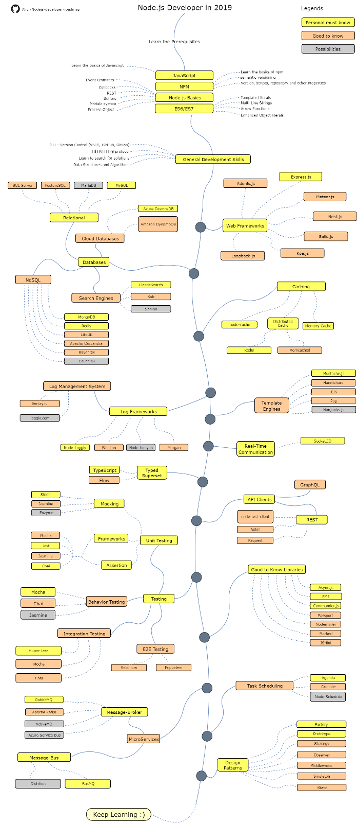
https://ifenna.hashnode.dev/nodejs-starter-kit-cjynbt9ur004vdps1hdl5rq5f?guid=none

Slide 5
Winner game: structure
Game issuers
Game (phone number randomizer)
Candidates
Game players
Winners

Slide 6
Winner game: game player
Candidates
Game
Game players
Winners

Slide 7
Winner game: Game issuer
Game issuers
Game
Candidates
Winners

